Slide 1

Besample Bot Analysis
Joshua Norfolk
TripleTen

Slide 2
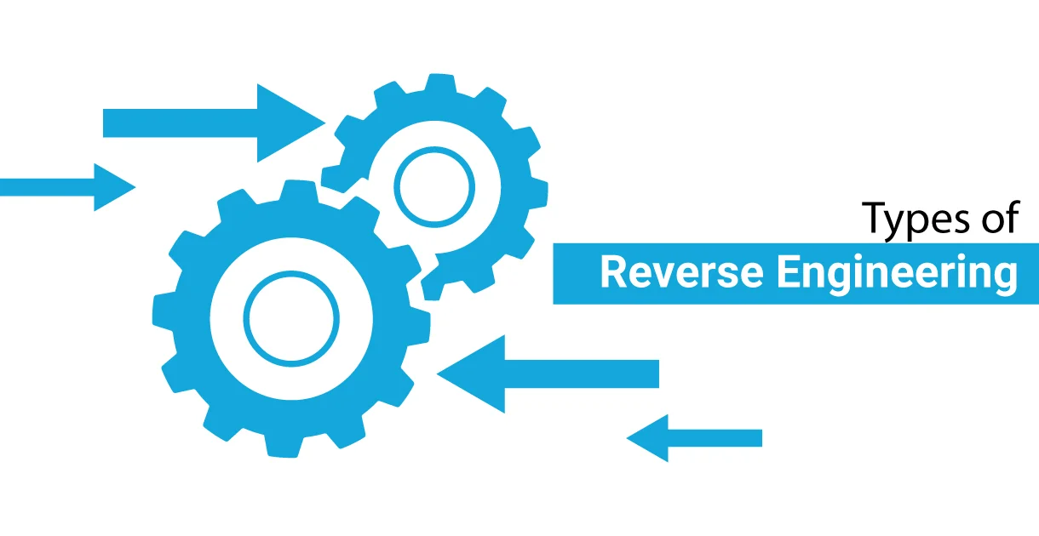
Reverse Engineering
Combining manual exploratory data analysis with machine learning
Start exploration with final outcome and work backward
Use mathematical modeling to reveal important characteristics of bots
Utilizing predetermined bot labels
Primary goal: support team’s findings
Notes:
Used predetermined bot labels despite potential inaccuracies – has been gauged to be sufficiently accurate

Slide 3
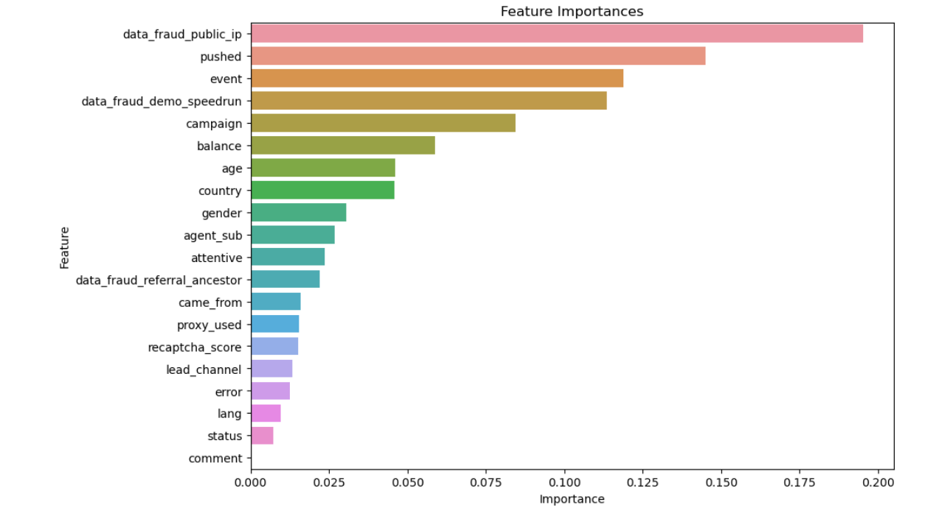
Feature Importances w/o Time Data
Notes:
You may know what “pushed” represents as this meaning was not accessible

Slide 4
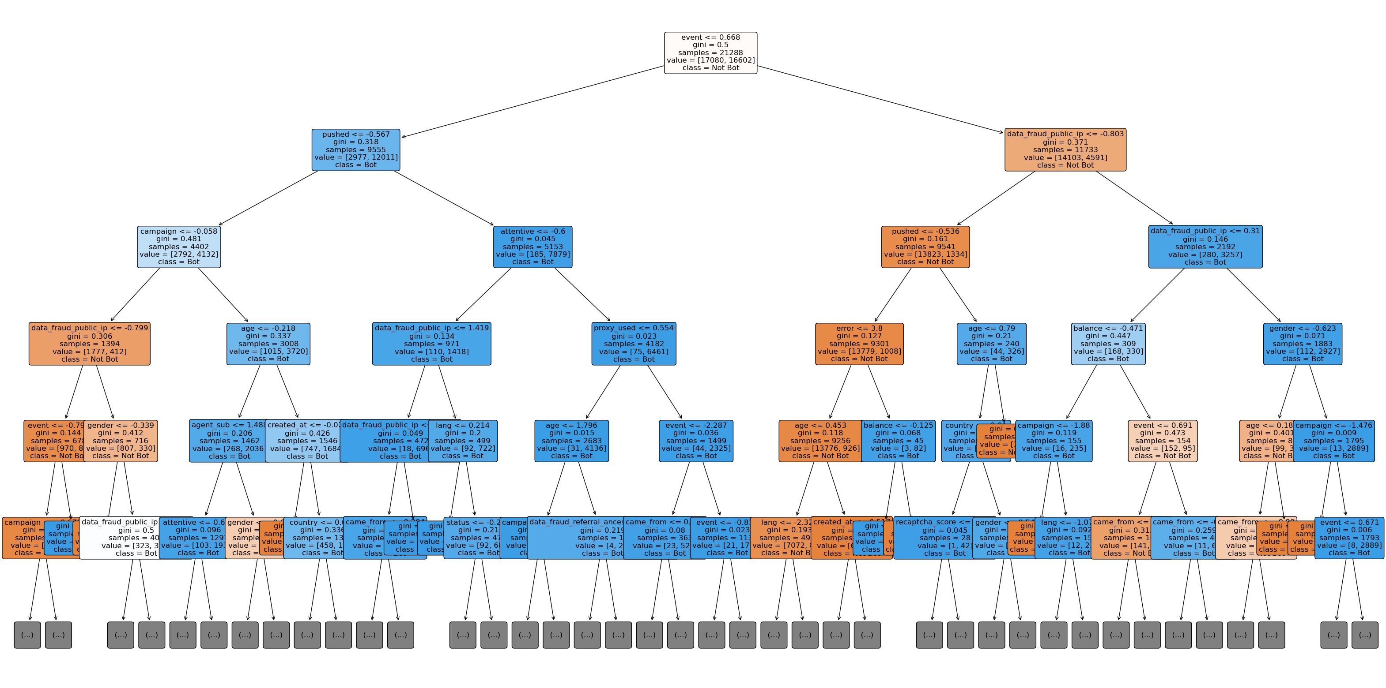
Decision Tree Branches w/o Time Data
Notes:
Just explain decision tree branches in general

Slide 5
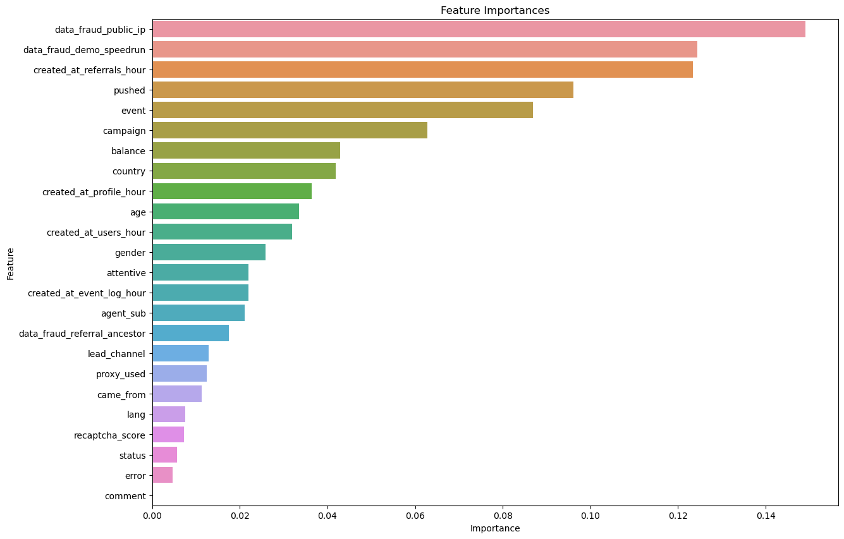
Feature Importances with Time Data
Notes:
Recaptcha and proxy are poor indicators.
Data fraud is important
The hour that referrals were created at appears to be substantial - perhaps bots get referred at irregular hours

Slide 6
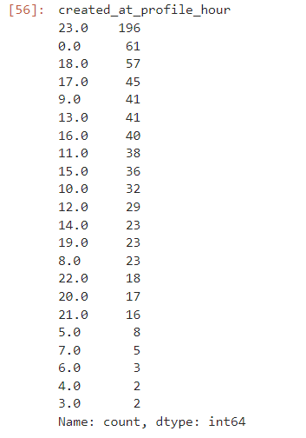
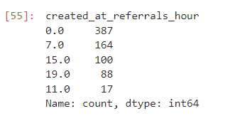
At what hour were bots referred? Profiles created?
Notes:
Times are standard across your data – if it is centered at British time, then 0 represents midnight in far western Europe. Many bots ostensibly came from Ukraine, so 0 would represent 2am.

Slide 7
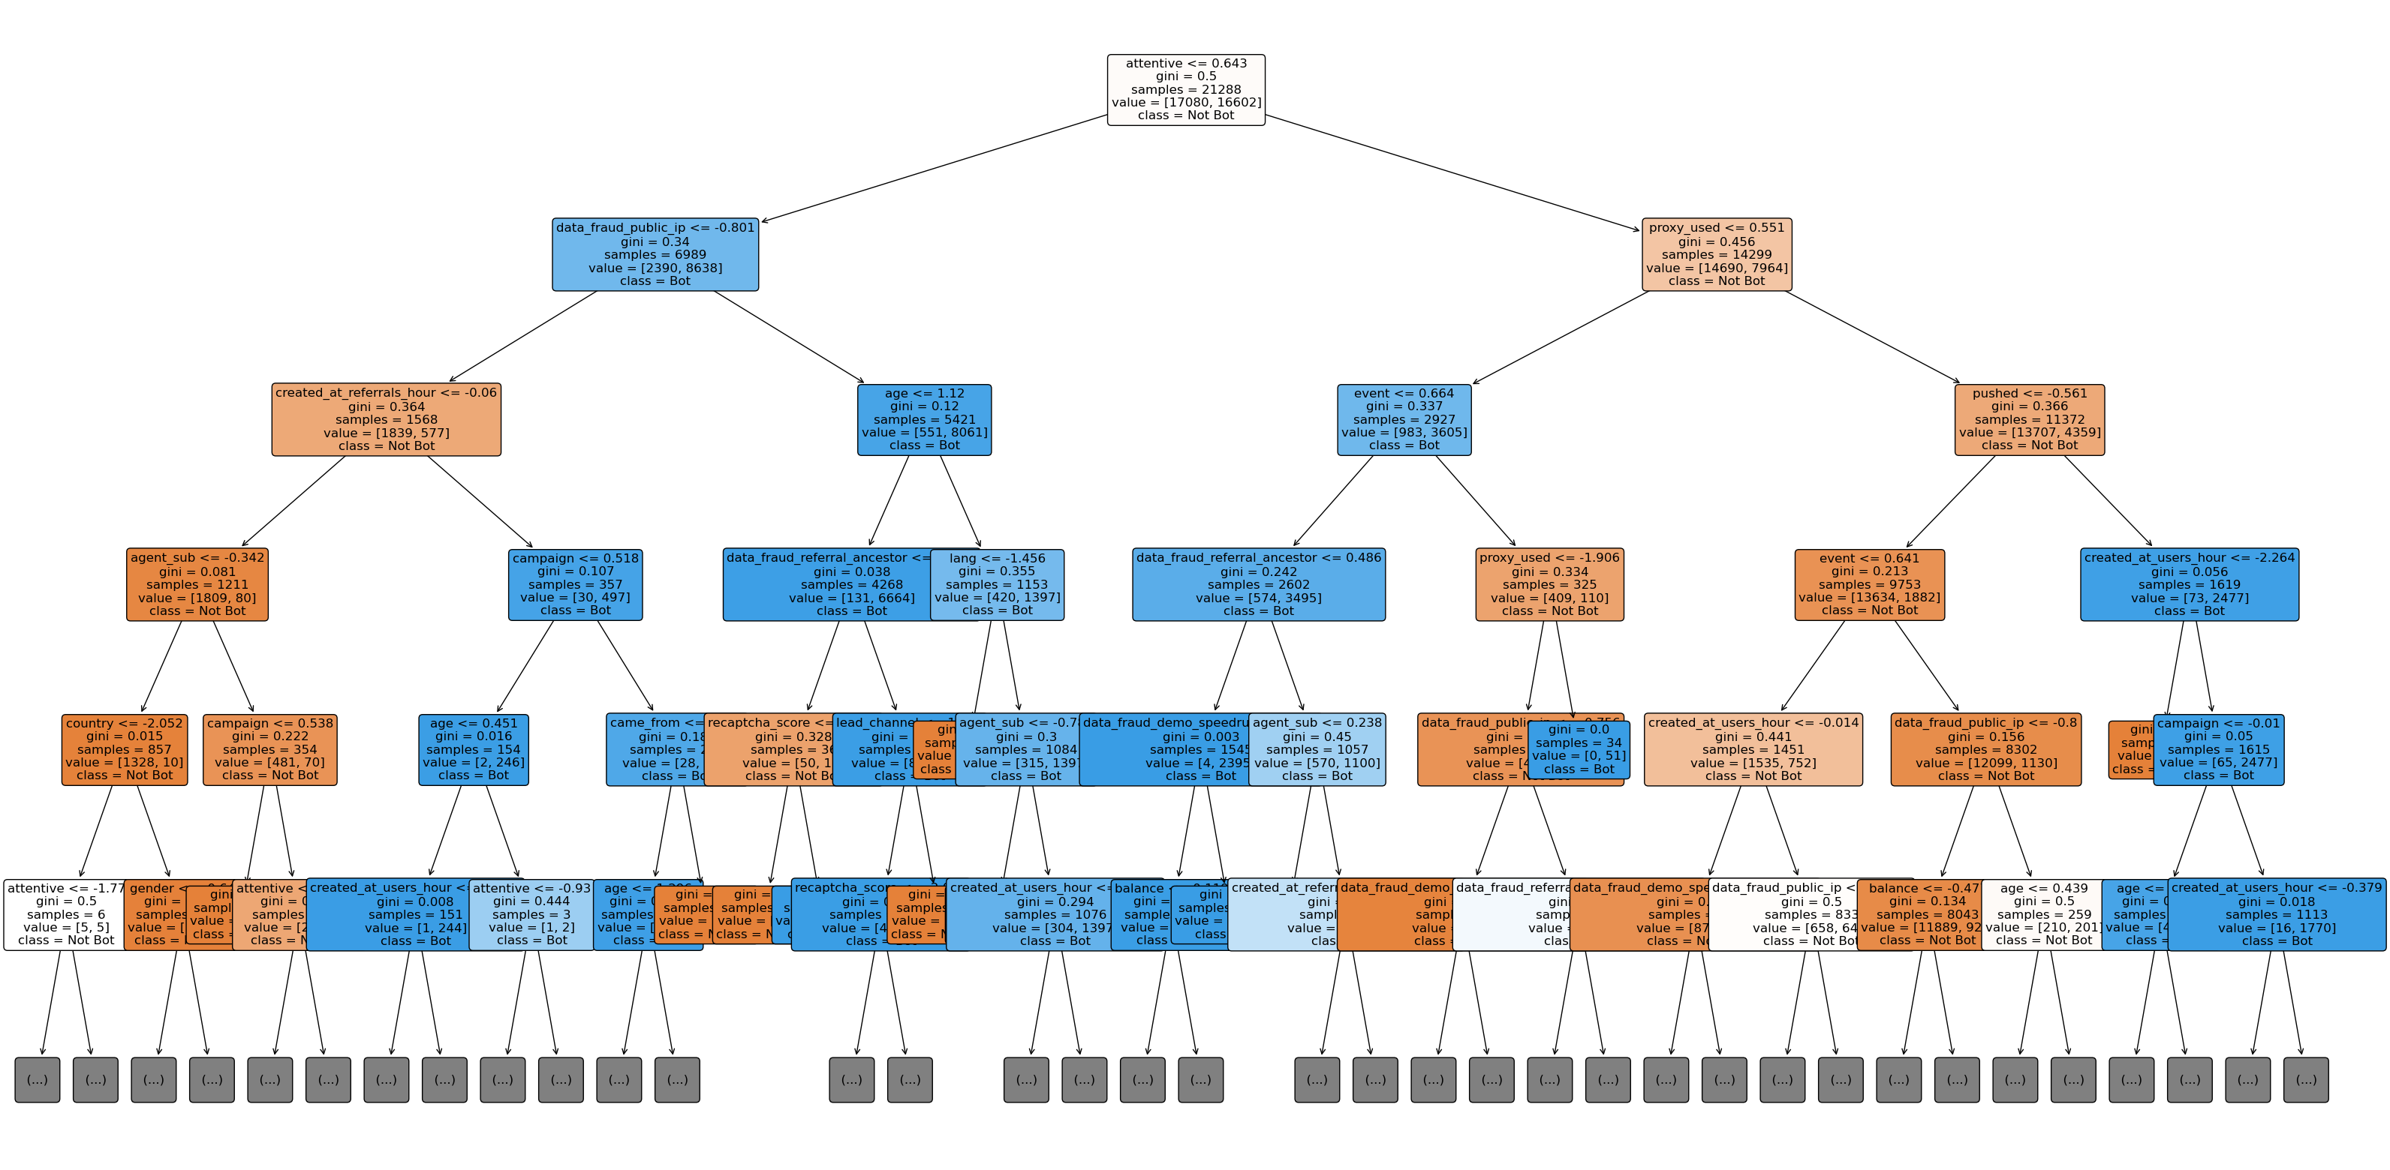
Decision Tree Branches w/ Time Data

Slide 8
Recommendations
Focus on your fraud labels for future users:
Public IP used?
Were the entries too fast?
At what hour were bot profiles referred or created?
Disregard ReCAPTCHA scores and whether or not a proxy was used.

Slide 9
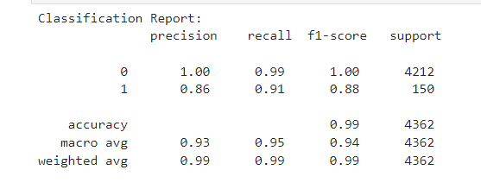
Appendix A: Classification Report for ML Model w/o Time Data

Slide 10
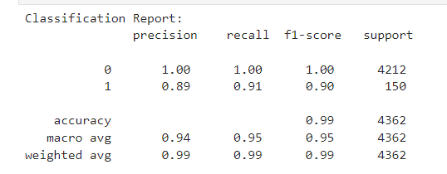
Appendix B: Classification Report for ML Model w/ Time Data

